Slide 1
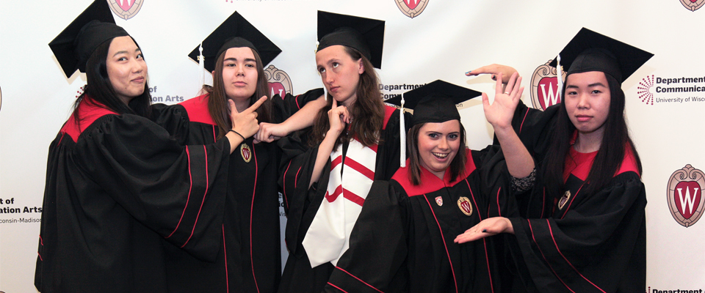
Declaring the Communication Arts Major

Slide 2

The Communication Arts Major:
Choose a Track
When you declare the Communication Arts major, you select a “track”:
Communication Science & Rhetorical Studies*
or
Radio-Television-Film*
Students may declare only one “track” in the major.
Monitor your progress with
DARS
Major requirement handout
* L&S students may complete either a BA or a BS with the major. If you would like to change your degree program, click here.

Slide 3

Advising
Com Arts Academic Advisor
Steffie Halverson
Advising appointments are scheduled through Starfish.
The Com Arts advising e-mail address is advising@commarts.wisc.edu
Career Advising
Letters & Science SuccessWorks
  See Career Communities

Slide 4

Answers to Frequently Asked Questions
Com Arts Alumni Careers at a Glance
What You Can Do with Your Com Arts Major
Student Organizations
More Frequently Asked Questions Answered

Slide 5

Apply for Scholarships, Awards, and
Internship Funding
Scholarships and Awards
Scott M. Broetzmann Scholarship in Communication Arts
Christopher Neal Heinlein Memorial Scholarships
S. Nelson and Carmella M. Nelson Scholarship
Schweitzer Family Scholarship Fund
Charline M. Wackman Awards for Summer Session
Charline M. Wackman Awards
Keith Harris Wyche Memorial Scholarships
The Hellum Award
The Nietzchka Keene Prize
Internship Funding
Communication Arts Department and Alumni Summer Internship Fund

Slide 6
Are You Ready to Declare the Com Arts Major?
(If you are a non-L&S student, who isn’t transferring into L&S, please see the next page.)
Letters and Science Students:
Please e-mail advising@commarts.wisc.edu
Your name
Campus id number
The track you are declaring:
  Communication Science & Rhetorical Studies
  Or
  Radio-TV-Film
  Please note: Communication Arts is proposing a track name change from Radio-TV-Film to Film and Media. By declaring the Comm Arts: Radio-TV-Film track at this time you acknowledge the track name may change to Film and Media during your time as a student
Non-Letters & Science Students who are transferring to L&S, please submit a request to transfer to L&S form. After you’ve been admitted to L&S, follow the instructions above.

Slide 7
Non-L&S Students Adding
Com Arts as an Additional Major
Please e-mail advising@commarts.wisc.edu
Your name
Campus id number
Wisc email
Your school/college
The track you are declaring:
  Communication Science & Rhetorical Studies
  Or
  Radio-TV-Film
  Please note: Communication Arts is proposing a track name change from Radio-TV-Film to Film and Media. By declaring the Comm Arts: Radio-TV-Film track at this time you acknowledge the track name may change to Film and Media during your time as a student
When you intend to graduate (if you know)
We will submit your request to declare the Communication Arts major as an additional major to your home school/college.

Slide 8
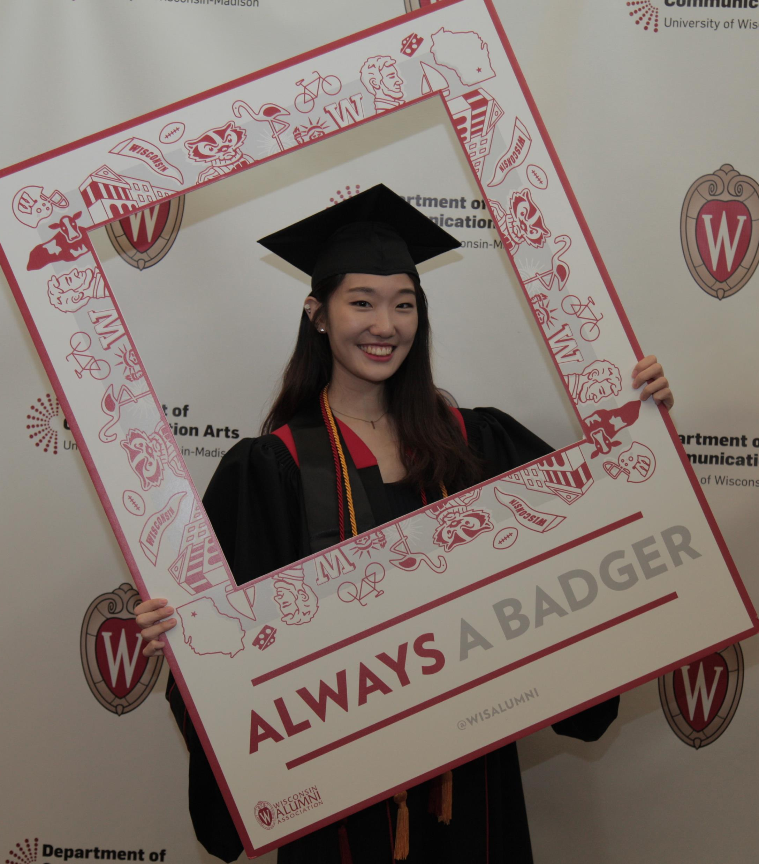
Welcome to the Com Arts Major!
Follow Com Arts on social media to stay up to date with fun events and student stories: linktr.ee/uwcommarts

